Slide 2
An Introduction to / Fundamentals of Internal Quality Assurance
ESG 2015
Presentation and discussion of the Introduction to the EIQAS GUIDE
A proposal/ draft
Madalena Fonseca (A3ES)

Slide 3
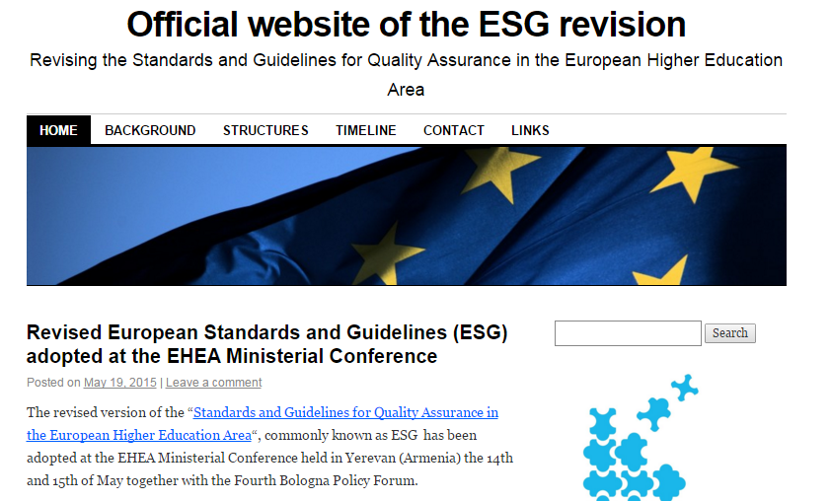
Standards and Guidelines for Quality Assurance in the European Higher Education Area

Slide 4
Setting the context
Higher education, research and innovation play a crucial role in supporting social cohesion, economic growth and global competitiveness. Given the desire for European societies to become increasingly knowledge-based, higher education is an essential component of socio-economic and cultural development. At the same time, an increasing demand for skills and competences requires higher education to respond in new ways.
A key goal of the Standards and Guidelines for Quality Assurance in the European Higher Education Area (ESG) is to contribute to the common understanding of quality assurance for learning and teaching across borders and among all stakeholders.

Slide 5
Scope and Concepts
The ESG are a set of standards and guidelines for internal and external quality assurance in higher education.
The focus of the ESG is on quality assurance related to learning and teaching in higher education, including the learning environment and relevant links to research and innovation.
The ESG apply to all higher education offered in the EHEA regardless of the mode of study or place of delivery.
At the heart of all quality assurance activities are the twin purposes of accountability and enhancement. Taken together, these create trust in the higher education institution’s performance.

Slide 6
Purposes and principles
The ESG have the following purposes:
They set a common framework for quality assurance systems for learning and teaching at European, national and institutional level;
They enable the assurance and improvement of quality of higher education in the European higher education area;
They support mutual trust, thus facilitating recognition and mobility within and across national borders;
They provide information on quality assurance in the EHEA

Slide 7
The ESG are based on the following four principles for quality assurance in the EHEA:
Higher education institutions have primary responsibility for the quality of their provision and its assurance;
Quality assurance responds to the diversity of higher education systems, institutions, programmes and students;
Quality assurance supports the development of a quality culture;
Quality assurance takes into account the needs and expectations of students, all other stakeholders and society.

Slide 8
The standards for quality assurance have been divided into three parts:
Internal quality assurance
External quality assurance
Quality assurance agencies

Slide 9
ESG
Part 1: Standards and guidelines for internal quality assurance
1.1 Policy for quality assurance
Standard:
Institutions should have a policy for quality assurance that is made public and forms part of their strategic management. Internal stakeholders should develop and implement this policy through appropriate structures and processes, while involving external stakeholders.
Referenciais A3ES nos processos de Auditoria aos Sistemas Internos de Garantia de Qualidade
Referencial 1 - Adoção de política e prossecução de objetivos de qualidade: A instituição consolidou uma cultura de qualidade, apoiada numa política e em objetivos de qualidade formalmente definidos e publicamente disponíveis.

Slide 10
ESG
Part 1: Standards and guidelines for internal quality assurance
1.2 Design and approval of programmes
Standard:
Institutions should have processes for the design and approval of their programmes. The programmes should be designed so that they meet the objectives set for them, including the intended learning outcomes. The qualification resulting from a programme should be clearly specified and communicated, and refer to the correct level of the national qualifications framework for higher education and, consequently, to the Framework for Qualifications of the European Higher Education Area.
Referenciais A3ES nos processos de Auditoria aos Sistemas Internos de Garantia de Qualidade
Referencial 2 – Definição da oferta formativa: A instituição dispõe de processos para a conceção e aprovação da sua oferta formativa, garantindo que os cursos ministrados são concebidos e estruturados de modo a que possam atingir os objetivos fixados, designadamente os objetivos de aprendizagem. A habilitação e a qualificação alcançadas em cada curso, bem como o correspondente nível nos quadros nacional e europeu de qualificações no ensino superior, são claramente especificados e publicitados.

Slide 11
ESG
Part 1: Standards and guidelines for internal quality assurance
1.3 Student-centred learning, teaching and assessment
Standard:
Institutions should ensure that the programmes are delivered in a way that encourages students to take an active role in creating the learning process, and that the assessment of students reflects this approach.
Referenciais A3ES nos processos de Auditoria aos Sistemas Internos de Garantia de Qualidade
Referencial 3 – Ensino, aprendizagem e avaliação centrados no estudante: A instituição adota os procedimentos mais adequados a assegurar que o ensino é ministrado de modo a favorecer um papel ativo do estudante na criação do processo de aprendizagem, bem como processos de avaliação dos estudantes que sejam consonantes com essa abordagem.

Slide 12
ESG
Part 1: Standards and guidelines for internal quality assurance
1.4 Student admission, progression, recognition and certification
Standard:
Institutions should consistently apply pre-defined and published regulations covering all phases of the student “life cycle”, e.g. student admission, progression, recognition and certification.
Referenciais A3ES nos processos de Auditoria aos Sistemas Internos de Garantia de Qualidade
Referencial 4 – Admissão de estudantes, progressão, reconhecimento e certificação: A instituição está dotada de regulamentos devidamente aprovados e publicitados cobrindo todas as fases do ciclo de estudos do estudante na instituição (e.g. a admissão do estudante, a progressão, o reconhecimento e a certificação), que aplica de forma consistente.

Slide 13
ESG
Part 1: Standards and guidelines for internal quality assurance
1.5 Teaching staff
Standard:
Institutions should assure themselves of the competence of their teachers. They should apply fair and transparent processes for the recruitment and development of the staff.
Referenciais A3ES nos processos de Auditoria aos Sistemas Internos de Garantia de Qualidade
Referencial 9 – Recursos humanos: A instituição conta com mecanismos apropriados, aplicados de forma justa e transparente, para assegurar que o recrutamento, gestão e formação do seu pessoal docente e pessoal de apoio se efetua com as devidas garantias de qualificação e competência para que possam cumprir com eficácia as funções que lhes são próprias.

Slide 14
ESG
Part 1: Standards and guidelines for internal quality assurance
1.6 Learning resources and student support
Standard:
Institutions should have appropriate funding for learning and teaching activities and ensure that adequate and readily accessible learning resources and student support are provided.
Referenciais A3ES nos processos de Auditoria aos Sistemas Internos de Garantia de Qualidade
Referencial 10 – Recursos materiais e serviços: A instituição está dotada de mecanismos que lhe permitem planear, gerir e melhorar os serviços e recursos materiais com vista ao desenvolvimento adequado das aprendizagens dos estudantes e demais atividades científico-pedagógicas.

Slide 15
ESG
Part 1: Standards and guidelines for internal quality assurance
1.7 Information management
Standard:
Institutions should ensure that they collect, analyse and use relevant information for the effective management of their programmes and other activities.
Referenciais A3ES nos processos de Auditoria aos Sistemas Internos de Garantia de Qualidade
Referencial 11 – Gestão da informação: A instituição está dotada de mecanismos que permitem garantir a recolha, análise e utilização dos resultados e de outra informação relevante para a gestão eficaz dos cursos e demais atividades.

Slide 16
ESG
Part 1: Standards and guidelines for internal quality assurance
1.8 Public information
Standard:
Institutions should publish information about their activities, including programmes, which is clear, accurate, objective, up-to date and readily accessible.
Referenciais A3ES nos processos de Auditoria aos Sistemas Internos de Garantia de Qualidade
Referencial 12 – Informação pública: A instituição está dotada de mecanismos que permitem a publicação de informação clara, precisa, objetiva, atualizada, imparcial e facilmente acessível acerca das atividades que desenvolve.
Incluindo a monitorização do trajeto dos seus diplomados por um período razoável de tempo, na perspetiva da empregabilidade (artigo 18º, alínea e) ii), da Lei nº 38/2007).

Slide 17
ESG
Part 1: Standards and guidelines for internal quality assurance
1.9 On-going monitoring and periodic review of programmes
Standard:
Institutions should monitor and periodically review their programmes to ensure that they achieve the objectives set for them and respond to the needs of students and society. These reviews should lead to continuous improvement of the programme. Any action planned or taken as a result should be communicated to all those concerned.
Referenciais A3ES nos processos de Auditoria aos Sistemas Internos de Garantia de Qualidade
Referencial 5 – Monitorização contínua e revisão periódica de programas: A instituição promove a monitorização e a revisão periódica dos seus cursos, de modo a assegurar que alcançam os objetivos para eles fixados e dão resposta às necessidades dos estudantes e da sociedade. As revisões efetuadas conduzem à melhoria contínua do curso e as ações planeadas ou executadas em resultado desse processo são comunicadas a todos os interessados.

Slide 18
ESG
Part 1: Standards and guidelines for internal quality assurance
1.10 Cyclical external quality assurance
Standard:
Institutions should undergo external quality assurance in line with the ESG on a cyclical basis.
Referenciais A3ES nos processos de Auditoria aos Sistemas Internos de Garantia de Qualidade
Referencial 13 – Caracter cíclico da garantia externa da qualidade: A instituição submete-se a processos de avaliação externa periódica, em linha com os Padrões e Orientações Europeus para o Ensino Superior (ESG).

Slide 19
ESG + 3:
Referenciais A3ES nos processos de Auditoria aos Sistemas Internos de Garantia de Qualidade
Referencial 6 – Investigação e desenvolvimento / Investigação orientada e desenvolvimento profissional de alto nível: A instituição está dotada de mecanismos para promover, avaliar e melhorar a atividade científica, tecnológica, artística e de desenvolvimento profissional de alto nível adequada à sua missão institucional.
Referencial 7 – Relações com o exterior: A instituição está dotada de mecanismos para promover, avaliar e melhorar a colaboração interinstitucional e com a comunidade, nomeadamente quanto ao seu contributo para o desenvolvimento regional e nacional.
Referencial 8 – Internacionalização: A instituição está dotada de mecanismos para promover, avaliar e melhorar as suas atividades de cooperação internacional.

Slide 20
Part 2: Standards for external quality assurance (I)
2.1 Consideration of internal quality assurance
External quality assurance should address the effectiveness of the internal quality assurance described in Part 1 of the ESG.
2.2 Designing methodologies fit for purpose
External quality assurance should be defined and designed specifically to ensure its fitness to achieve the aims and objectives set for it, while taking into account relevant regulations. Stakeholders should be involved in its design and continuous improvement.
2.3 Implementing processes
External quality assurance processes should be reliable, useful, pre-defined, implemented consistently and published.
They include
a self-assessment or equivalent;
an external assessment normally including a site visit;
a report resulting from the external assessment;
a consistent follow-up

Slide 21
Part 2: Standards for external quality assurance (II)
2.4 Peer-review experts
External quality assurance should be carried out by groups of external experts that include (a) student member(s).
2.5 Criteria for outcomes
Any outcomes or judgements made as the result of external quality assurance should be based on explicit and published criteria that are applied consistently, irrespective of whether the process leads to a formal decision.
2.6 Reporting
Full reports by the experts should be published, clear and accessible to the academic community, external partners and other interested individuals. If the agency takes any formal decision based on the reports, the decision should be published together with the report.
2.7 Complaints and appeals
Complaints and appeals processes should be clearly defined as part of the design of external quality assurance processes and communicated to the institutions.

Slide 22
Part 3: Standards for quality assurance agencies (I)
3.1 Activities, policy and processes for quality assurance
Agencies should undertake external quality assurance activities as defined in Part 2 of the ESG on a regular basis. They should have clear and explicit goals and objectives that are part of their publicly available mission statement. These should translate into the daily work of the agency. Agencies should ensure the involvement of stakeholders in their governance and work.
3.2 Official status
Agencies should have an established legal basis and should be formally recognised as quality assurance agencies by competent public authorities.
3.3 Independence
Agencies should be independent and act autonomously. They should have full responsibility for their operations and the outcomes of those operations without third party influence.

Slide 23
Part 3: Standards for quality assurance agencies (II)
3.4 Thematic analysis
Agencies should regularly publish reports that describe and analyse the general findings of their external quality assurance activities.
3.5 Resources
Agencies should have adequate and appropriate resources, both human and financial, to carry out their work.
3.6 Internal quality assurance and professional conduct
Agencies should have in place processes for internal quality assurance related to defining, assuring and enhancing the quality and integrity of their activities.
3.7 Cyclical external review of agencies
Agencies should undergo an external review at least once every five years in order to demonstrate their compliance with the ESG.

