Slide 1
Internal Quality Assurance systems in Portugal: what their strengths and weaknesses reveal
EIQAS
Enhancing Internal Quality Assurance Systems
Erasmus Plus Project
Training Event 3 Lisboa
18 – 22 January 2016

Slide 2
The Portuguese Agency for Assessment and Accreditation of Higher Education (the Agency) formally stated that the main responsibility for the quality of education lies with each higher education institution, and has been encouraging and supporting institutions to implement internal quality assurance systems. Legislation also determines that institutions should develop an internal quality assurance policy for their programmes, a culture of quality and quality assurance in their activities, and a strategy for continuous quality improvement.
The Agency has introduced a system for internal quality assurance certifications. The certifications, therefore, would represent a guarantee of the institutions’ quality assurance capacity and, consequently, are intended to trigger lighter accreditation procedures. This development could be interpreted as an attempt to restore trust in universities, to restate quality as their responsibility, and to give ownership for quality to their constituent bodies, in accordance with a quality enhancement approach.
Notes:
The Agency started operations in 2009.
So far its activity is focused mainly on programme accreditation
However it has decided to help institutions to create IQAS, a legal requirement
A system for certification of IQAS was established aiming to the implementation of lighter touch approaches

Slide 3
A number of institutions have already undertaken the certification and both self-assessment and external assessment reports are available. One element common to both kinds of reports are the identified strengths and weaknesses of the internal quality assurance systems.
The Agency intended to analyse the nature of institutional strengths and weaknesses highlighted in these evaluation reports, laying bare a double perspective: an internal one offered by institutions themselves and an external one offered by external evaluation panels.
In particular, it aimed to understand whether strengths and weaknesses are related to procedural and organisational matters or to cultural change (values and beliefs). This would also offer an insight into the quality culture(s) which characterise HEIs in Portugal.

Slide 4
The Cultural Theory was proposed by Mary Douglas (1970, 1982) in the 70’s, and was developed by Michael Thompson, Richard Ellis and Aaron Wildavsky in the 90’s
The cultural framework assumes grid and group dimensions. The grid dimension refers to regulation externally defined and narrows the field of action, i.e. – the set of rules and norms that regulate the interactions of individuals. The group dimension is based on the sense of boundaries assuming that actions are driven by the concern of the benefit of the group, i.e. – the extent to which the life of individuals relies on group membership.
For Thompson, Ellis and Wildavsky (1990) the combination of grid and group originates four ways of life: fatalism – strong regulation and weak group; individualism – weak regulation and weak group; hierarchy – strong regulation and strong group; egalitarianism – weak regulation and strong group. There is an additional way of life often placed at the centre of the diagram, the autonomous or hermit – deliberate exclusion.
Notes:
Grid dimension – rules and norms: legislation, professional associations, etc.
Group dimension – belonging to a faculty, an association, a specific discipline

Slide 5
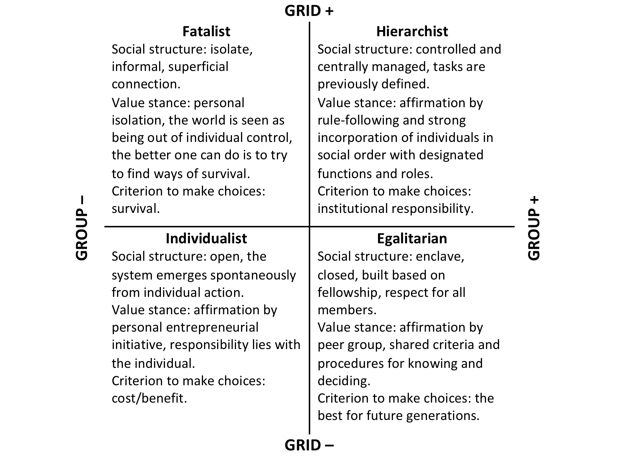

Slide 6
The grid/group typology generating four ways of life should be used specially as an analytical tool. Grid (regulation) and group (membership) are two dimensions of sociality. The concept of way of life stems from categories of social life generated from the degree of group involvement and the degree of social interaction.
We have used the Cultural Theory for reading the perceptions about the impact of quality systems derived from viable combinations of biases and social relations – the ways of life. And to interpret the diverse reactions of academics from different disciplines to quality assurance.
Harvey and Stensaker have used the cultural theory to to simplify and help to operationalise the concept of quality culture. They proposed four ideal types inspired by cultural theory (Douglas 1982; Thompson et al. 1990). The typology captures the degree of group control and the intensity of external rules. The combination of these two dimensions results in four different quality cultures: regenerative, responsive, reproductive and reactive

Slide 7
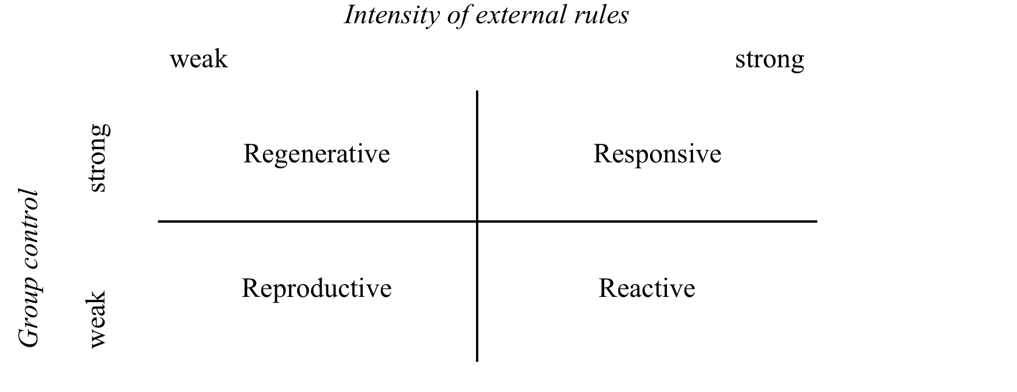
Ideal types of quality culture (Adapted from Harvey and Stensaker 2008).

Slide 8
The regenerative quality culture is characterised by strong group-control and weak sensitivity to external rules. It is focused on internal developments and follows a coordinated plan for internal regeneration which is widely shared and owned. It is indistinguishable from everyday activities. It incorporates opportunities or imperatives promoted by external forces as long as they make a positive contribution to the internally developed vision and goals.
The responsive quality culture is strong on both dimensions: group control and intensity of external rules. Yet, external imperatives are the dominant drivers, and the institution takes advantage of these in order to devise an internal, forward-looking improvement agenda, but not losing sight of accountability and compliance. Its shortcoming resides in a lack of staff ownership of the quality culture, unconnected with their everyday practice.

Slide 9
The reproductive quality culture is weak both as regards group control and the influence of external rules. In a reproductive mode, the institution has established norms and is reluctant to redefine future goals. The quality culture is indistinguishable from everyday practice, but it is not transparent because embedded in taken-for-granted practices. Attempts to re-think quality in a critical way meet heavy resistance.
The reactive quality culture is characterised by a strong influence of external rules, and a weak degree of group control. It is driven by compliance and accountability, imposed by and constructed around external drivers, and there are reservations about the potential positive outcomes of quality evaluation. In the reactive mode, there is little or no sense of ownership and quality is delegated to a specific unit (quality office). For academics, it amounts to a box-ticking exercise.

Slide 10
The implementation of internal quality assurance systems is likely to bear the mark of institutional quality cultures. It is expected that the analysis of the identified weaknesses and strengths will shed light on the type of quality culture(s) which characterises the institutions. Based on this information, it might be possible to ascertain whether these institutions are embracing improvement alongside accountability.
The documents used were self-evaluation and external reports from the certification process of IQAS. The documents were imported into MaxQDA, a qualitative analysis software, to enable data organisation and systematic analysis. The analysis followed a grounded-theory methodology in a two-step process adapted from Strauss and Corbin’s method (1990): open and selective coding.

Slide 11
The analysis revealed five main categories in the following order of importance:
Organisation of internal quality assurance (e.g. policies, structures, procedures, regulations, tools);
Information management (e.g. efficiency and fitness-for-purpose of information system, articulation with quality system, data collection/analysis)
Participation of stakeholders (internal/external);
Staff (recruitment, appraisal, development, reward and recognition)
Information dissemination (internal/external, transparency)
These categories were prevalent both in the case of identified strengths and weaknesses for the IQAS

Slide 12
Both strengths and weaknesses of IQAS generally fell under the same broad categories, with some minor variations. This is indicative of the fact that these dimensions are deemed as the most important for the robustness and good functioning of an internal quality assurance system.
Internal and external reports from both types of institutions considered the organisation of quality assurance as the main strength of IQAS. However, it was equally recognised unanimously that an insufficiently developed/formalised organisation constituted a weakness of the IQAS.
A noteworthy difference is evident between universities and polytechnics. The latter place more emphasis on the organisation of QA than the former, denoting more concern with structural elements and formal procedures. Since polytechnics have a more recent history than universities and were included in quality assessment later, this could reflect the more incipient stage in the development of their QAs. This betrays higher preoccupation with setting up structures and procedures, evident both on the strengths and the weaknesses.

Slide 13
Consistency in perceptions about the importance of the information management for the effective functioning of IQAS was encountered in the internal and external reports, both for universities and polytechnics, although higher in the case of universities.
Self-evaluations identified stakeholder participation primarily as a strength and less so as a weakness. In contrast, it was identified more as a weakness than as a strength by external reports. This suggests that the analysed institutions appear more confident about how they engage stakeholders than the external reviewers, who are more critical in this respect.
Aspects related to the participation of stakeholders emerge much more in polytechnics than in universities, both with respect to strengths and to weaknesses. When identified as a weakness, it might be due to the fact that polytechnics, given their more vocational orientation, employ staff who at the same time maintain professional practice and, thus, may find it more difficult to fully engage this staff with their everyday activities which go beyond teaching.

Slide 14
The lack of participation of external stakeholders was also predominantly criticised in the case of polytechnics. As their mission implies more responsiveness to their local environment, expectations of involvement of external stakeholders are higher than in universities.
The staff dimension was more frequently highlighted as a weakness of IQAS, rather than as a strength, both by internal and external reports. At the same time, internal reports pinpoint this dimension more than external reports, suggesting it is a rather sensitive issue for the analysed institutions. Again, it emerged much more in the case of polytechnics.
For information dissemination, internal reports saw it predominantly as a strength, whereas external reports identified it almost exclusively as a weakness. These mismatched perceptions could suggest that this is an area which needs more attention by institutions.

Slide 15
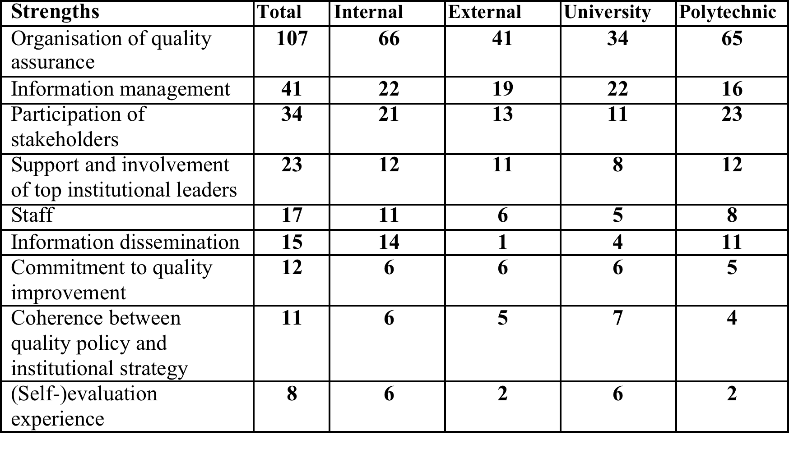

Slide 16
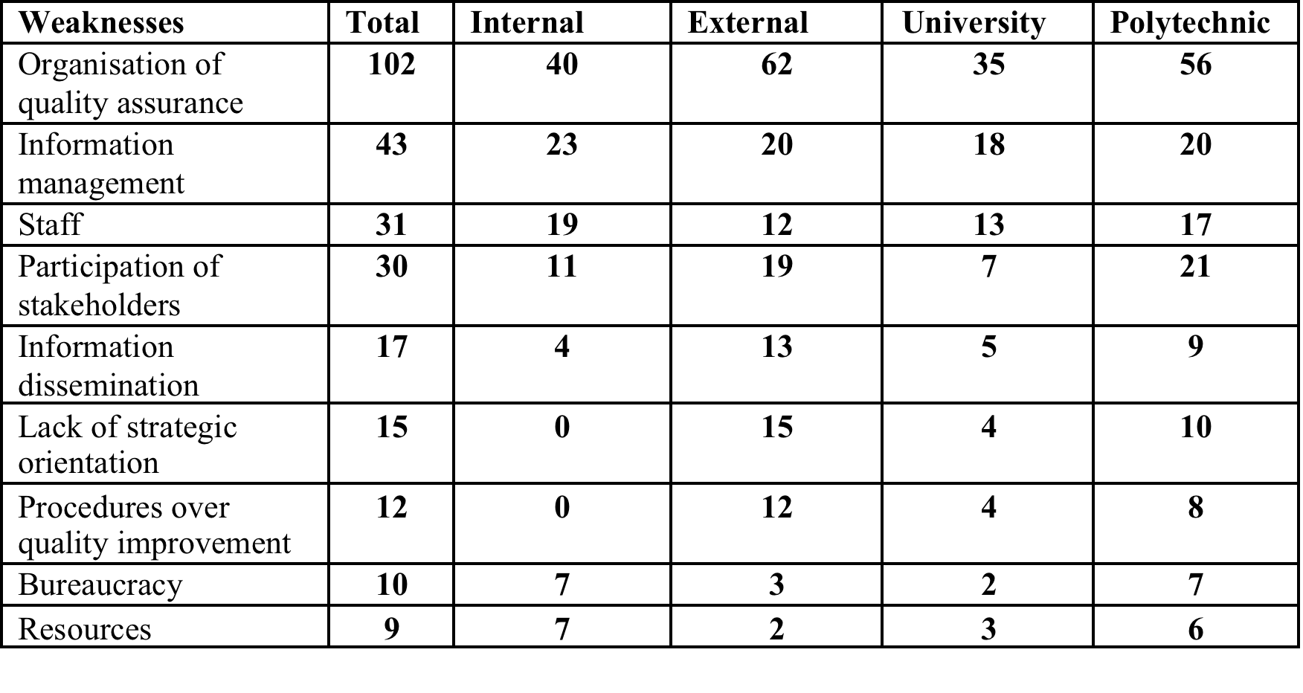

Slide 17
The emphasis on formal, structural and procedural aspects – as denoted by the prevalent emphasis on organisation of the quality system and the information management system – is indicative of the understanding of quality more as a structural or managerial element with well-defined processes (including definition of tasks, standards, responsibilities, units etc.), and less as shared values and commitment to improvement (EUA, 2006). Consequently, it also betrays that the analysed institutions are, at the moment, more concerned with accountability when implementing quality assurance systems.

Slide 18
The four ideal types of quality culture (Harvey and Stensaker 2008) captured the interplay between the intensity of external rules and the intensity of group control. In the light of the recent legal requirements that institutions should develop and implement internal quality assurance systems, reinforced by the incentive of lighter accreditation once these systems obtain external certification, one could assume that the intensity of external rules is strong in Portugal.
For this reason, the quality cultures of Portuguese institutions applying for certification will be either reactive or responsive. A reactive culture is solely concerned with accountability and compliance, seeing external rules as an imposition which will not bring any additional value. In contrast, a responsive quality culture pursues improvement alongside accountability, and external drivers are seen as an opportunity to change practices for the better.

Slide 19
From the aspects identified as strengths and weaknesses in the analysis, the intensity of group control can, to some extent, be inferred particularly from one main analytical category, stakeholder participation. The participation of stakeholders, mainly internal, in quality assurance was deemed more as a strength from the internal perspective, and more as a weakness in external assessment.
The external perspective goes further by alerting to the fact that institutions, in their concern of getting the processes and the procedures right, tend to lose sight of the greater aim which is quality improvement. This criticism gave rise to a separate analytical category under weaknesses, procedures over quality improvement (see Table 2).

Slide 20
The above account suggests that the quality culture of the analysed Portuguese institutions is somewhere between responsive and reactive, depending on the internal or external perspective respectively. Moreover, since the external reports point towards more weaknesses related to the participation of stakeholders and to the prioritisation of procedures over improvement in polytechnics rather than in universities, one could argue that the former appear more reactive, whereas the latter more responsive.

Slide 21
The analysis intended to understand whether these strengths and weaknesses are associated with procedural and structural matters or with cultural change manifest in values and beliefs. With this, it aimed to gain insight into the quality culture(s) of the analysed institutions and, by extension, whether these were embracing improvement alongside accountability, in line with the intentions of the Agency when introducing the certification of internal quality assurance systems.
The identified strengths and weaknesses were predominantly associated to the organisation of the quality assurance system and to information management, namely with formal structures and procedures rather than with quality in the transformative sense of the concept (Harvey and Newton 2007).

Slide 22
With the objective of avoiding burdensome accreditation in the future, institutions feel compelled to implement an internal quality system and apply for its certification. Although the Agency’s intentions were to encourage a shift towards improvement, it appears that accountability continues to be, for the time being, a more pressing concern than improvement. This, in turn, reveals that the analysed institutions find themselves somewhere on the continuum between a reactive and a responsive quality culture.
Since, only a limited number of Portuguese institutions have so far applied for certification, it would be unwise to draw general conclusions for the Portuguese institutions as a whole. However, the findings can provide helpful insights (e.g. good practices or issues requiring attention) for the institutions which have yet to apply for certification. Moreover, the systematic analysis of the strengths and weaknesses identified so far in the implementation of internal quality assurance systems could also be a helpful tool for the quality agency in its decisions on further support and guidance to institutions.

