Slide 1
Guide to IQA - introduction.
Izabela Kwiatkowska-Sujka
and
Mieczyslaw W. Socha
EIQAS Dissemination Event, Warsaw 9 February 2017

Slide 2
1. Do we really need another guide? if so, how does it differ from the others? what is its added value?
The novelty is that the Guide
is closely linked with the strategic stakeholders needs and expectations demonstrated in a survey, training seminars and dissemination conferences;
is a product of large group of authors representing all strategic stakeholders and different perspectives;
is a source of inspiration not restrictive, rigorous instruction; it’s pretty generic to be useful for all types of HEIs;
does not concentrate on the technical issues of the IQAS but rather underlines strategic approach to the IQAS and quality enhancement with emphasis on those areas where there is a particular interpretation required for quality assurance standards;
is an example of OMC for QA in higher education

Slide 3
1. Do we really need another guide? if so, how does it differ from the others? what is its added value?
is compatible with the latest trends in the development of IQA and EQA;
may be useful tool not only for quality assurance system enhancement, but quality culture development (it sets clear expectations and supports sharing of good practices, and strengthens the student voice in quality);
is not closed but living document; an open source tools with continuous improvement;
Is it still a practical guide? Yes, as understanding IQAS fundamentals is perhaps more important than knowledge of its procedures; when poorly understood, the quality system will be weak, inefficient and resisted by the academic community

Slide 4
2. What are the main objectives and aims of the Guide?
To raise stakeholders’ awareness of IQAS within the ESG context; instead of debating the contents of quality processes, procedures, tools, priority is given to the reflection, engagement and cooperation with stakeholders, that all involved parties are enjoying,
To provide different perspectives of various stakeholders when discussing the theoretical part, challenges, and examples of good practices;
To showing what the European standards on accountability procedures and enhancement means for the IQA, how ESG may be used to build own systems?

Slide 5
2. What are the main objectives and aims of the Guide?
To identify the most difficult parts of the IQAS to be designed and implement;
To set key questions to be answer for further reflection
To share experience and disseminate good practices i.e. to promote potential for institutional-spillover

Slide 6
3. What is the conceptual framework of this Guide?
ESG
What constitutes the core IQAS, independent of external forces?
How important are the internal and external factors in the designing and development of the IQAS?
How to define link between academic QA and employability of graduates?
What are the links with the internationalization of HE (preparing for international accreditations: global QA frameworks; JP)?

Slide 7
4. Who may benefit from this guide?
Students and academic staff – raising awareness, engagement and responsibility for quality of learning and teaching;
University managers and quality assurance officers - foster continuous improvement of the quality of education; emphasizes of what systematic actions are needed to provide adequate confidence in IQAS;
Quality assurance agencies - background for building trust, confidence and partnership between QAA and HEIs; PKA?
Assessors involved in EQA - what is important in assessing IQAS, how to approach the dilemmas/conflicts between prescribed standards compliance and innovative practices in IQAS;
MNSW – Minister’s bedtime reading for reflective enlightenment?

Slide 8
5. Will the Guide be useful in the (uncertain) future?
Open source tool
The Guide will be reviewed on an annual basis by quality assurance agencies engaged in the project and updated whenever is needed

Slide 9
6. What do we expect from the audience?
Does the Guide fit the specific needs of the Polish HEIs?
What should be added, removed or change?
Reflect on the trades-offs and possible fields of conflicts between (HoF Wittenburg Institute, accessed 29 December 2016):
academic freedom and stakeholders expectations
theory and practice,
the research and teaching function of higher education institutions,
natural science and the humanities/social sciences,
education and training,
tradition and innovation

Slide 10
7. ESG 1.1. Institutions should have a policy for quality assurance that is made public and forms part of their strategic management. Internal stakeholders should develop and implement this policy through appropriate structures and processes, while involving external stakeholders
Have the vision, mission, strategy, quality assurance policy been defined within the HEI context?
Is QAP expressed in terms of outcomes?
Are QAP goals/objectives feasible?
Are QAP goals/objectives feasible?
Would you describe QA as one of the core function of the University?
Integrity: does QAP cover key (10 ESG) areas?
Do you have a management plan to show how your QA activities are operationalized?
How do you ensure consistency across discipline, programmes, faculties, departments and other units?

Slide 11
7. ESG 1.1. Institutions should have a policy for quality assurance that is made public and forms part of their strategic management. Internal stakeholders should develop and implement this policy through appropriate structures and processes, while involving external stakeholders
Is terminology understandable and clear for stakeholders? QCtrl, QA, QI, QE, QC
How within your present system do you make judgements on strategic efforts to make what do better (i.e. to enhance it)
What gives you reassurance that the current procedures do not interfere more than necessary with the normal work of the university?
How do you enable stakeholders to comment on IQAS? Do students and staff understand (and accept ) quality goals and IQAS?
Who owns IQAS?

Slide 12
7. ESG 1.10. Institutions should undergo external quality assurance in line with the ESG on a cyclical basis.
What are the evidence that it is forward-looking?
Does it provide a framework for ongoing institutional development and self-evaluation?
How are you able to ensure that lessons learned in previous cycle are applied in the next one?
How formal system is support by the informal quality assurance system?
How is it enhanced by external evaluation outcomes? Does it enhanced at all?

Slide 13
9. Is Poland’s EQA different?
Quality assurance allows people to have confidence in the quality of higher education.
Every higher education institution should have a rigorous system of internal quality assurance,
assessed by Quality Assurance Agencies which make external checks.
(European Commission, www.ec.europa.eu last update 04/02/2017)

Slide 14
9. Is Poland’s EQA different?
QA has a twin purpose of accountability (securing compliance with minimum standards) and enhancement.
Agencies explore more flexible and lighter procedures leaving primary responsibility for QA within the HEIs and focussing on quality enhancement
Common trends include a stronger focus on internal quality assurance, more stakeholder engagement and further internationalisation of quality assurance.
Institutional assessments have recently become more prominent.
The only sample country with a focus on programmes is Poland, where the quality assurance agency performs reviews of study programmes and of organisational units within HEIs
Source: UNIVERSITY QUALITY INDICATORS: A CRITICAL ASSESSMENT (European Parliament, 2015)

Slide 15
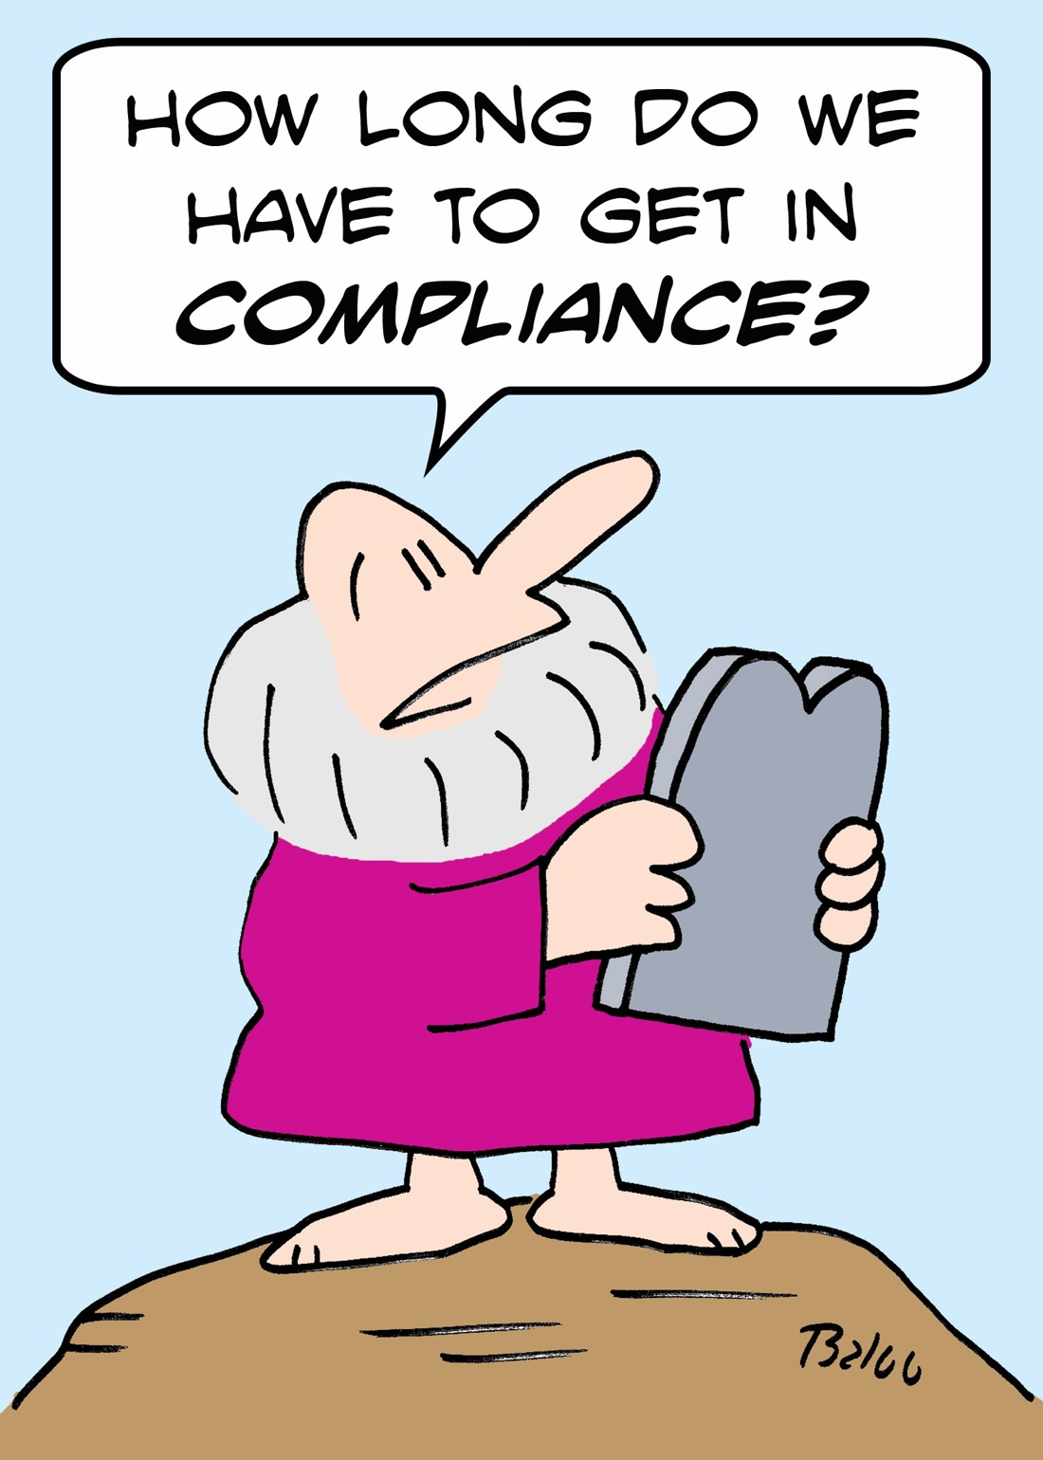
8. ESG 2015 What HEI may expect from PKA?

Slide 16
9. Does checklist still matter?
ATUL GAWANDE, THE CHECKLIST MANIFESTO: HOW TO GET THINGS RIGHT ? (Metropolitan Books Henry Holt and Company, LLC , 2009)
We have accumulated stupendous know-how. We have put it in the hands of some of the most highly trained, highly skilled, and hardworking people ( ... )Nonetheless, that know-how is often unmanagable. Avoidable failures are common and persistent, not to mention demoralizing and frustrating, across many fields—from medicine to finance, business to government. And the reason is increasingly evident: the volume and complexity of what we know has exceeded our individual ability to deliver its benefits correctly, safely, or reliably.
That means we need a different strategy for overcoming failure, one that builds on experience and takes advantage of the knowledge people have but somehow also makes up for our inevitable human inadequacies.
And there is such a strategy—though it will seem almost ridiculous in its simplicity, maybe even crazy…It is a checklist.

Slide 17
9. Does checklist still matter?
 | NVAO | FINNHEC
First level criteria | 4 | 6
Second level criteria | Guidlines: 22 | 15
Third level criteria |  | 18-21
 |  | Absent, emerging, developing, advanced

Slide 18
9. Does checklist still matter?
 | The Commission on Institutions of Higher Education, New England Association of Schools and Colleges | Higher Learning Commission of the North Central Association
First level criteria | 9 | 5
Second level criteria | 184 | 21
Third level criteria |  | 67
Accredited HEIs | Harvard University; MIT | University of Chicago since 1913

Slide 19
What is the future of institutional evaluation in Poland?
www.eiqas.com

Slide 20
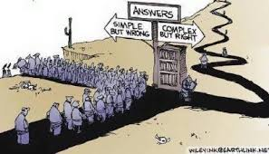
Thank you for your attention! www.eiqas.com

