Slide 1
Presentation of Internal Quality Assurance System: University of Nova Gorica, Slovenia
EIQAS, Training Event 1, Warsaw, 26th –30th June 2015
Veronika Piccinini

Slide 2
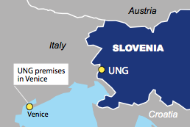
University of Nova Gorica
Small, non-state, research-based, internationally oriented
7 schools, 6 research laboratories, 6 research centres
1995: establishment, 2006: status of university
2014/15: 548, 181 & 100⁺
1:<5

Slide 3
IQA system of University of Nova Gorica
Central management – flexibility
UNG bodies: Rector (legal rep.) UNG Senate, Governing Board, Stud. Council, 2 Vice-Rectors, International Council (advisory body)
Bologna reform of all study programmes completed in 2007
2013-2015: EU & national funds for the project Modernization of the quality assurance system and reform of programmes at UNG

Slide 4
IQA system of University of Nova Gorica
Revision of programmes (inv. all stakeholders)
Student-centered learning promoted
Course syllabi revised, student survey questionnaires and certain rules updated
Practical placements, tutorship system introduced
E-learning learning opportunities enhanced, online information system upgraded
ESG

Slide 5
IQA system
IQA system of University of Nova Gorica
Self-evaluation is the primary mechanism for IQA and the development of quality culture
2013: Quality Manual (former Methodology of monitoring and assurance of quality of pedagogical and research work at UNG)
IQA procedures in compliance with the national legislation (Higher Education Act, acts adopted by SQAA – institutional and programme accreditetion) and ESG; ESG explicitly referred to in the Quality Manual
Formally adopted, published
Quality management at UNG is incorporated in the management of the university; the responsibility borne by the Rector of UNG, Vice-Rectors, Deans of schools, and by Heads of UNG research units.

Slide 6
Quality Assurance Committee
IQA system of University of Nova Gorica
Responsible (at UNG level) for the implementation of QA activities, for presenting the proposals and initiatives for the development of quality culture and the updating of procedures and strategies, as well as for constant improvements of quality
President, 1 representative per school, student representative (weak point: no member of support staff)
Rules of Procedure, regular meetings
Responsible for UNG self-evaluation report (adopted by the UNG Senate) – analytical report including guidelines for improvement and checklist of annual progress

Slide 7
At school level: Quality Coordinator
IQA system of University of Nova Gorica
Also member of UNG QAC
Monitors self-evaluation elements throughout the year
Gathering information: e-surveys, School’s Senate sessions, UNG Strategic Panels, regular meetings with the Dean, support services, in contact with staff and students, external stakeholders
Proposes improvements to QAC/Dean of school
Involved in the procedures for the design and approval of programmes

Slide 8
IQA system of University of Nova Gorica
Progress monitored, actions taken documented (Reports to QAC (2/year)
Together with the Dean, the Coordinator analyses the students’ questionnaires at the end of each academic year. (Newly adopted change: all findings should be published also in a manner to be understood by the students – adapted versions of findings of questionnaires shall be sent to students via the online information system (the latter cannot fully interpret the results)
Responsible for producing the School’s annual self-evaluation report, together with other stakeholders) – annual monitoring of progress + contributes to UNG self-evaluation report
Reports published, feedback communicated to all stakeholders within UNG circle of quality

Slide 10
Explicit reference to ESG – Chapter 2 of QA Manual
IQA system of University of Nova Gorica
Introduction
Quality assurance strategies
Methodology of monitoring and assurance of quality of UNG study programmes
3.1 Structure of self-evaluation reports
3.2 Procedures for monitoring and assurance of quality, quality circle
Monitoring and assurance of quality of research work
Involvement of students in the process of monitoring and quality assurance
Credit system ECTS (recognition of the students’ knowledge obtained elsewhere)

Slide 11
Strengths of UNG IQA system
IQA system of University of Nova Gorica
UNG’s small size is seen as an advantage
Specific internal structure of UNG, centralised management, unified strategies and procedures for QA
Specific orientation – specific areas of research and teaching: 3rd-cycle study programme Karstology (QA procedures reflected on a global scale)
Strong international orientation and at the same time strong links with the local community, contributing to the development of the local economy, creating a pool of highly trained experts in specific fields – karstology, viticulture and enology etc.)

Slide 12
Compliance with the standards of Part 1 of ESG
IQA system of University of Nova Gorica
1.1 Policy for quality assurance
1.2 Design and approval of programmes
1.3 Student-centered learning, teaching and assessment
1.4 Student admission, progression, recognition and certification
1.5 Teaching staff
1.6 Learning resources and student support
1.7 Information management
1.8 Public information
1.9 On-going monitoring and periodic review of programmes
1.10 Cyclical external quality assurance

Slide 13
IQA system of University of Nova Gorica
Good practices in current activities
SWOT 2014; strength: high employability of graduates (enhanced cooperation with local companies and organisations – introduction of practical placement, student projects; survey aimed at employers to evaluate graduates’ competences – feedback) 1.2 – Design and approval of programmes, practival placements
SWOT 2014; strength: adaptability, fast response to changes (possible due to small size of UNG, weekly sessions of management bodies), personalised approach towards internal stakeholders and regular meetings with external stakeholders 1.1 Policy for quality assurance

Slide 14
IQA system of University of Nova Gorica
Good practices in current activities
Provision of unique study programmes in specialised areas, related to the local environment – doctoral programme Karstology (effect on enrolment rate, no. of. international students) (1.2 – Design and approval of programmes)
“Double-monitoring” of students’ satisfaction – 2 parallel (formal and informal) ways of gathering feedback; lecturers’ own initiatives (recognised as good practice by EUA Evaluation Committee) (1.9 – On-going monitoring and periodic review of programmes)
Introducing the concept of Partner schools
Students: system of Tutorship (teacher-student), a unique tailored scheme of studies for students-athletes (1.6 – Learning resources and student support)

Slide 15
IQA system of University of Nova Gorica
Short-term plan:
The newly-established centralised system of professional development opportunities for staff should be enhanced)
(In line with the revised ESG – esp. amendments of standard 1.5)

Slide 16
IQA system of University of Nova Gorica
How do you identify good practices in IQA?
What is the scope of good practice? Definition of the word “scope”:
The extent of the area or subject matter that something deals with
The opportunity or possibility to do or deal with something The scope for major change … (Source: Online Oxford Dictionary)

Slide 17
IQA system of University of Nova Gorica
How do you evaluate the effectiveness of good practices?
Obstacles: diversity of activities, long-term process, time needed to obtain relevant/measurable results, lack of guidelines for evaluating the effectiveness
Self-evaluation processes (Formal: analysis of findings in self-evaluation reports, analysis of results of questionnaires, UNG SWOT analysis, observations noted in the reports of Quality Coordinators; informal gathering of information from stakeholders)

Slide 18
IQA system of University of Nova Gorica
External evaluation processes (SQAA – maximum accreditation periods awarded to UNG and its programmes, institutional EUA (European University Association) evaluation in 2014/15, Thomson-Reuters profile, U-Multirank Performance Profile – excellence especially in the fields of research and international orientation)

Slide 19
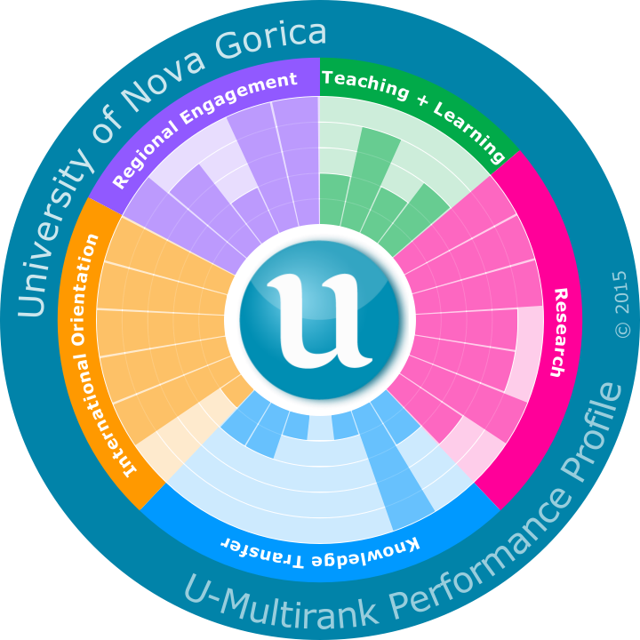
UNG U-Multirank Performance Profile 2015
Good practices reflected in areas of excellence

Slide 20
Do you find any obstacles or threats linked to its inappropriate use/or further development?
Funding: State funds for concessions and research activities have been scarce since, preventing a favourable development of pedagogical and research activities. Funding of UNG in 2013: 61.3 % - research funds, of which over 50 % obtained from international projects – lack of permanently employed staff (affecting the implementation of several ESG standards)
In certain cases the national legislation impedes the development of the IQAs (due to the limitations prescribed by the national legislation in terms of language of instruction certain new study programmes cannot be introduced, the no. of international students and staff cannot increase to the level desired (affecting esp. the implementation of standards 1.2, 1.4)

Slide 21
What is the value added for your university?
IQA procedures designed in the manner helping the institution to accomplish its vision and achieve the set goals
Beneficial effect on UNG graduates’ employability rates
Enhancement of the quality culture in the broadest sense
Contribution to the development of the local/national economy and the selected scientific disciplines

Slide 22
EIQAS, Training Event 1, Warsaw, 26th –30th June 2015
www.ung.si
veronika.piccinini@ung.si

